Slide 1
Presented By
Binny Kaur
Presented To
Prof. Shashi Shahi

Slide 2









WELCOME
Netflix, the streaming giant that has revolutionized the way we consume entertainment, has emerged as the ultimate destination for millions of viewers around the globe. Since its inception in 1997 as a DVD-by-mail rental service, Netflix has evolved into a dominant force in the entertainment industry, offering an extensive library of movies, TV shows, documentaries, and original content. With a strong emphasis on convenience, variety, and quality, Netflix has redefined the way we experience television and film.
In this Netflix dashboard, we delve into the world of Netflix, exploring its vast content catalog, innovative features, and the ever-evolving landscape of streaming entertainment.

Slide 3
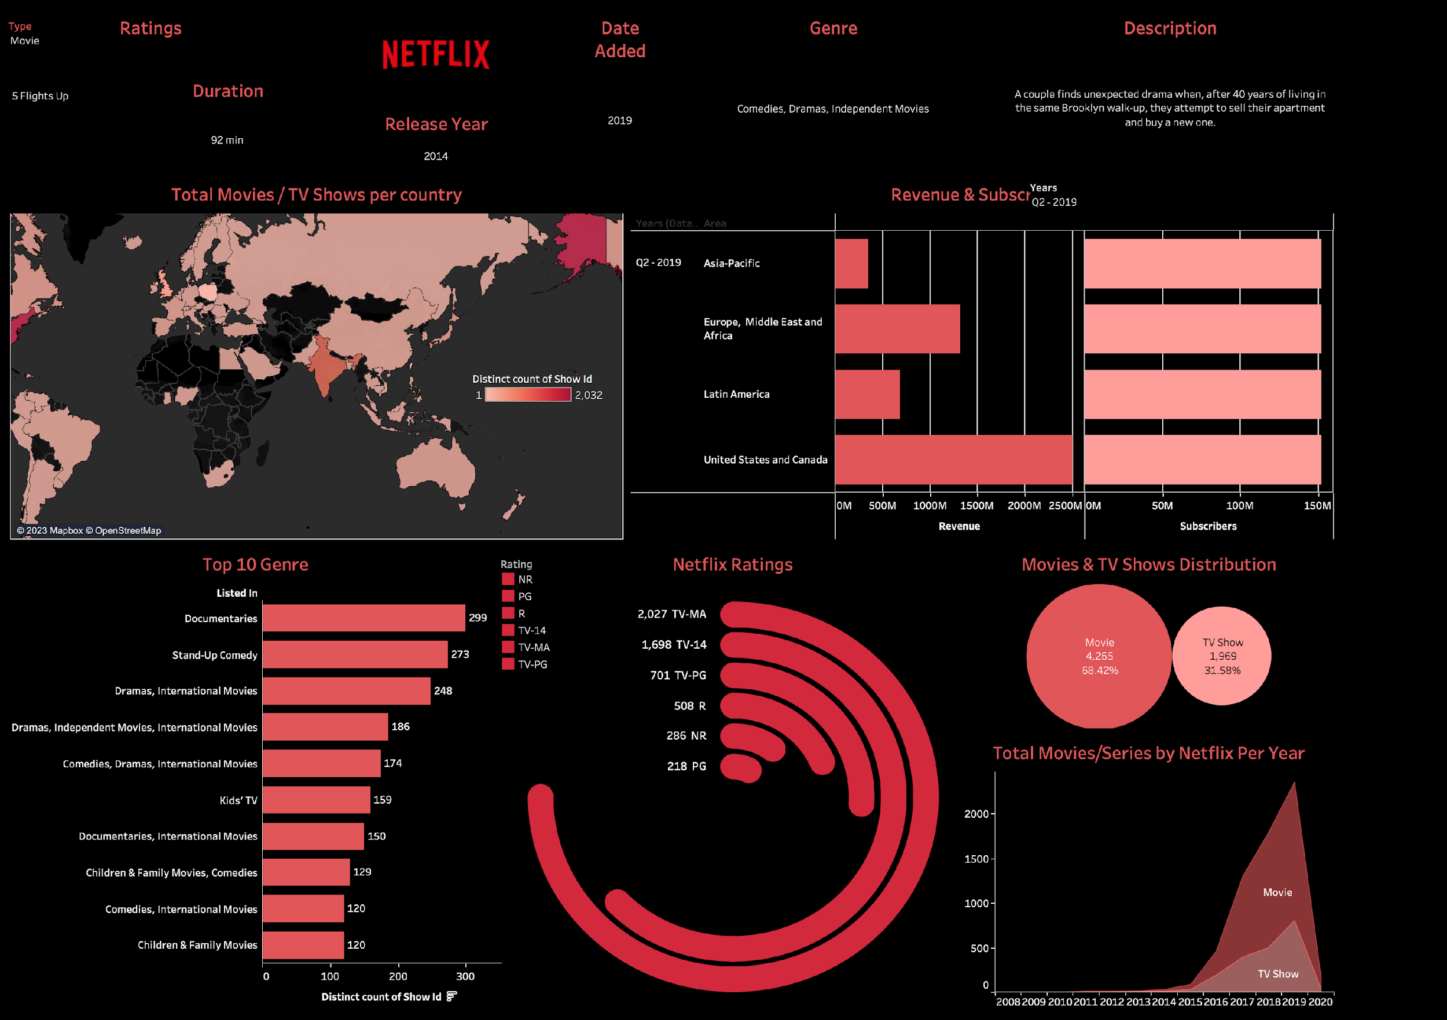
DASHBOARD LAYOUT

Slide 4
Tools. Used for Data Visualisation
Total Movies & Tv shows per country (Map Graph)
Top 10 Genre (Bar Graph)
Movies & TV shows distribution as whole share (Bubble Graph)
Total Movies & TV Shows per year(Line Graph)
Ratings (Radial spiral graph)
Revenues & Subscribers per quarter (Bar Graph)

Slide 5

DATA ANALYSIS
This Netflix Tableau Dashboard provides insights on it’s overall company profile as an OTT platform.
The graphs and figures used displays different demographics captured by each genre of content that Netflix produces.
Comparison between the quantum of Movies and TV Shows produced can be easily inflicted.
Identify average duration of Movies and TV Shows
We can examine average ratings of Movies and TV Shows.
Identify any changes in genre popularity over time.
Determine if there are any regional preference that determine the trend.
Identify highly rated titles and genres.
Identify trends in the production of Movies and TV Shows demographically.
Examining revenue per region can help understand the potentially areas of growth for the company.
Subscribers trend per year can help company focus on marketing campaigns for a particular region.

Slide 6

THANK YOU

